Slide 1
Indicators and Intelligence
Incident Response

Slide 2
Threat Intelligence
Information about adversaries
Intelligence gathered about adversaries
Threat landscape
Need to understand how adversaries operate
Broad -> Specific
Broad to understand their techniques, useful for hunting + anomaly based searches
Specific to understand exactly what they look like, useful for signatures
Learn the tools, techniques, and infrastructure of adversaries
Threat landscapes vary between organizations
Even by the same adversary

Slide 3
Understand your risk
To begin to understand the threat, you need to characterize your org’s risk
Risk == Vulnerability + Impact + Threat
Vulnerability
What exposure does your system have?
Any known weaknesses that could be leveraged?
Impact
What happens if you are compromised?
Not something that can be changed by the organization, often just a factor of what what the organization is/has
Threat

Slide 4
Risk – the threat
Why would an adversary want to compromise the org?
Does the adversary want to compromise the org?
Do they gain anything?
What do they gain?
What capabilities does the adversary have?
Does the adversary have the technical capability for successful compromise?
Do identified vulnerabilities align with an adversary’s capabilities?

Slide 5
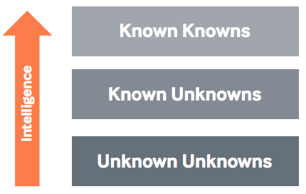
Threat Intelligence
The idea is to have more risks in the known knowns category
Ideally, as few unknown unknowns as possible
Can come from many different sources
News report about an attack on a flaw
-to-
Learning how an adversary is targeting a competing organization
The UK’s National Cyber Security Centre divides threat intelligence into four categories
Strategic
Operational
Tactical
Technical

Slide 6
Strategic Intelligence
High level
Typically acquired at the board or high senior manager level
Not technical information
Typically about an attack’s potential
Financial impact
Impact on business decisions
Example:
A report states a foreign government hacks into foreign companies with direct competitors in their own nation
Your organization is identified as a competitor

Slide 7
Operational Intelligence
Information about a specific incoming attack
Typically acquired by high level security staff
Rarely available
Typically only a government has access to such information
No legal way for private companies to access this info on their own
Rare cases the info may be available
Public actors (hacktivists)
Link cyber attacks to real world events

Slide 8
Tactical Intelligence
Information about how adversaries are conducting their attacks
TTPs – Tactics, Techniques, and Procedures
Typically acquired by defenders and incident responders
Example:
Learning an adversary is using psexec to move laterally
Block remote logins by admins and/or log and monitor this activity
Typically obtained through:
Talking with other defenders about what they’re seeing
Purchasing a threat feed of this information
White papers

Slide 9
Technical Intelligence
Deeply technical data consumed through technical methods
Example:
Feed of malicious IP addresses
Feed of malicious domain names
Feed of malicious software hashes
Often a short timeline – attackers can change IP addresses
Often feeds monitoring and alerting solutions

Slide 10
Threat Intelligence Feeds
Feed of indicators or artifacts from a third party
Often focus on one indicator area
IP addresses
Domains
Hashes
Real-time
Automatically updates with the latest available threat information
Some free feeds, many paid feeds
Six main data source types – ideally cover as many as possible
Open Source
Customer telemetry
Honeypots
Scanning/crawling
Malware processing
Human intelligence

Slide 11
Indicator of Compromise (IOC)
Identifies characteristics of malware
Host-based and network-based characteristics
Can be used to identify the presence of malware on a compromised host
IOCs are typically created by reversing malware
Professional responders typically have large IOC lists collected from previous intrusions they have worked
IOCs can save you time when analyzing multiple hosts
Even if you only have one IOC for one piece of malware you found
Various ”standard” languages to share indicators and threat intelligence

Slide 12
Standard sharing languages
Standardization is important!
Makes sharing easier
Makes working with multiple data sources easier
Different logs often refer to the same thing by different names
Logged on
Login success
Accepted password
Account Logon
Sharing between different systems within the organization
Sharing with other organizations
Need a common language to speak

Slide 13
CybOX
Cybox.mitre.org
Cyber Observable eXpression
Standardized schema for describing observable events
Event logging
Malware characterization
Intrusion detection
Incident response
Attack pattern characterization
Standard structure and content
…has been rolled into STIX the past few years

Slide 14
STIX
Stix.mitre.org
Structured Threat Information eXpression
Community driven
Standardized language to represent structured threat information
Some examples:
Malware Indicator for File Hash
File Hash Reputation
Incident Essentials – Who, What, When
Affected Asset list
Command and Control IP List

Slide 15
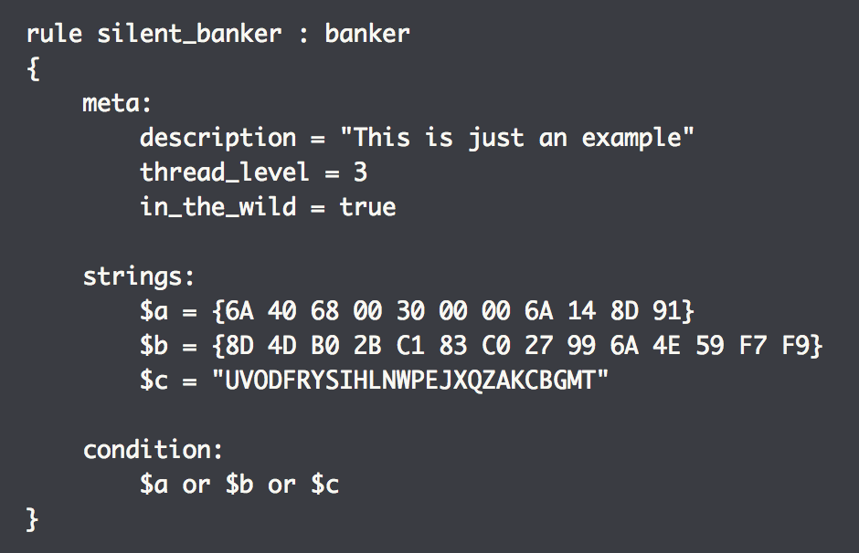
YARA
Tool used to help identify and classify malware
“Pattern matching swiss knife for malware researchers (and everyone else)”
Create descriptions based on patterns
Each rule has a set of strings and Boolean logic
Any file containing one of the three strings is reported as a silent_banker match

Slide 16
OpenIOC
Openioc.org
Open framework for threat intelligence sharing
Originally designed for Mandiant’s products
Has since been standardized and open sourced
IOCs are stored as XML
IOC is made up of three major parts
IOC Metadata
Author of the IOC, Name of the IOC, description, etc.
References
Investigation name, case number, comments, etc
Definition
The content of the IOC itself – artifacts, MD5 hash, registry path, etc.

Slide 17
OpenIOC
IOC Editor
Allows users to work with indicators in XML format
Manage the fields within the IOCs
Edit the IOCs
IOC Finder
Search for IOCs on a single host
Can be used to test new OICs
Can be used to find malware on hosts
IOC hit reporting in various formats, including HTML and text
Reports for single or multiple hosts

Slide 18
Lab - OpenIOC

